Slide 1
Efficient data hiding system using LZW, Cryptography and Image Steganography with a hybrid approach
by
Amit Singh
Nayan Solanki

Slide 2
Aim: To combine the strength of Cryptography and Steganography with compression. The main focus of this project is to combine the all different trends which are already been proposed in the direction of cryptography and steganography to reduce the time and space in terms of transmission over the network.
Objective:
To study the security mechanism in currently existing system.
To study and develop the module required for steganography to make the appearance of secret data invisible to any outside intruder.
To study and develop the algorithms that can be used for easy encryption and decryption with image steganography.
To study and develop the modules that can be used to reduce the time and space complexity during transmission over the network.
To study and develop the modules that can used for lossless compression and decompression method.

Slide 3
Problem Statement
Current steganography project is having complexity problem in terms of time per Data. Nowadays Steganography project can hide data in equal length of image file, For Example it can hide 1Mb data with at least (Or More than) 1Mb Image file, it means that for extracting 1Mb data we have to download at least (OR more than) 2Mb file (i.e. 50% loss of data or more than 50% loss). And also, its cost of transmission is more. Second problem is, it takes more time for a complete transmission from sender to receiver.

Slide 4
Paper 1: Combined Strength of Steganography and Cryptography
Literature Review
Aishwarya Baby Hema Krishnan
P.G Scholar Assistant Professor
FISAT, Mookkannooor, Kerala, India FISAT, Mookkannooor, Kerala, India
Content referred:
The use of internet for communication purpose has rapidly increased and it magnified the attacks to users. Protecting the data is a big challenge for computer users. Cryptography and Steganography are widely used techniques to ensure security. Both techniques have many applications in computer science and other related fields. Both methods provide security in their own ways, but to add multiple layers of security it is always a good practice to use combination of these techniques. The concepts of steganography, cryptography and their applications in the security of digital data communication across network is studied in this paper and technical survey of recent methods which combined steganography and cryptography is presented.

Slide 5
Paper 2: An Efficient Cryptography Using HASH-LSB Steganography with RC4 and Pixel Shuffling Encryption Algorithms
Assit.Lec. May H.Abood
Computer Engineering dept
College of Engineering, Al-iraqia University
Baghdad, Iraq.
Content referred:
This paper improves information security through developing efficient image cryptography algorithm by using encryption with steganography. The proposed algorithm ensures the encryption and decryption using RC4 stream cipher and RGB pixel shuffling with steganography by using hash-least significant Bit (HLSB) that make use of hash function to developed significant way to insert data bits in LSB bits of RGB pixels of cover image. The security evaluations are presented by calculating a peak signal to noise ratio and mean square error. For secret image, PSNR is infinity and MSE is 0. For cover image, PSNR is about 63 dB and MSE is about 0.03. The results show that high level of the similarity exists between the stage-images and cover images and the same is for secret images and extracted image as represented also in In Histogram Analysis of secret images. These algorithms are performed by using MATLAB program.

Slide 6
Paper 3:
Efficient Data Hiding System using LZW, Cryptography and GIF Image Steganography
Intisar Majeed Saleh, Hanna Hameed Merah
AL. Rubidian University College
Baghdad, Iraq.
Content referred:
The combination of steganography and cryptography is considered as one of the best security methods used for message protection, due to this reason, in this paper, a data hiding system that is based on image steganography and cryptography is proposed to secure data transfer between the source and destination. Animated GIF image is chosen as a carrier file format for the steganography due to a wide use in web pages and a LSB (Least Significant Bits) algorithm is employed to hide the message inside the colors of the pixels of an animated GIF image frames. To increase the security of hiding, each frame of GIF image is converted to 256 color BMP image and the palette of them is sorted and reassign each pixel to its new index, furthermore, the message is encrypted by LZW (Lempel –Ziv-Welch) compression algorithm before being hidden in the image frames. The proposed system was evaluated for effectiveness and the result shows that, the encryption and decryption methods used for developing the system make the security of the proposed system more efficient in securing data from unauthorized users. The system is therefore, recommended to be used by the Internet users for establishing a more secure communication.

Slide 7
Project Concept
To develop a system which provides additional security at the client side as well as at the server side. At the client a new layer of security is to be added over the existing username and password based system compression scheme is used to optimize the size of secret data, it will enable a person to hide approx. 2 times more data in a cover-image, i.e. Now we can store Double Amount of Data into Same Image File. This Way we can reduce the cost of data and we can also reduce loss of data up to 50%. This approach is secure against the RS detection attack and its steno-image is totally indistinguishable from the original image (cover-image) by the human eye And By using Hybrid Approach we can reduce transmission time by Extracting data parallelly at decoding time. This way we can reduce some amount of transmission time.

Slide 8
Block Diagram
At sender end:
At receiver end:
Start
Transmission
Input
Messages
Decode
Image File
Compression
Decryption
Image File
Encryption
Decompression
Encode
Message
Output
Transmission
Stop

Slide 9
Technical Details
Hardware Requirements
Processor : Pentium Dual Core
Speed : 1.65 GHzs(Or more than)
Motherboard : Genuine Intel
RAM : 128Mb(Or more than)
Hard Disk Drive : 512Mb(Or more than)
Software Requirements
Operating System : Windows 7
Application Type : Windows App
IDE Platform : NetBeans
Coding Language : JAVA Programming

Slide 10
Applications
Confidential communication and secret data storing
Protection of data alteration
Access control system for digital content distribution
Media Database systems
Limitations
For steganographic communication to function, the recipients must have some reason to look for hidden messages
Steganographic communication often requires a “shared secret.” Such shared secrets may be when and where to look for hidden messages, and how to extract hidden information once obtained. This information must remain secret; otherwise the goal of hidden communication is defeated
Once an image has been used to hide a message, the original should be destroyed. Otherwise, someone may notice the difference between the original and stego-image

Slide 11
Scope
The proposed system is able to perform steganographic techniques on text files, image files, and audio files and on video files as well. The product also supports encryption and compression. It should also ensure that only authenticated users can open the software. The software also includes a feature known as scheduler in the product with the help of which end user can schedule the steganographic tasks for the future time as well.

Slide 12
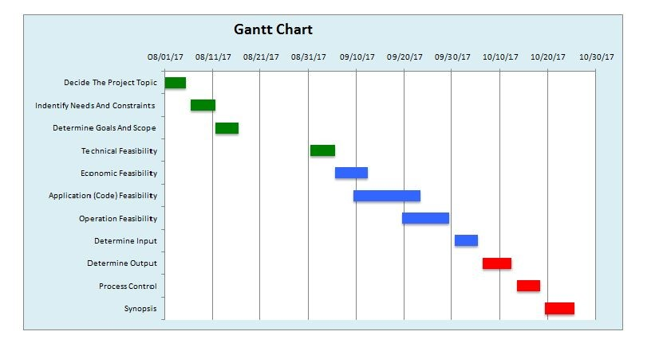
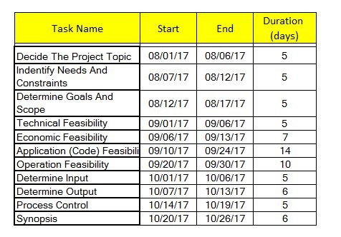
Implementation Plan

